Slide 1
Text to Video of various PIB Press Releases using Artificial Intelligence /Machine Learning/Generative Adversarial Networks in English and 13 Regional Languages viz. Hindi, Urdu, Punjabi, Gujarati, Marathi, Telugu, Kannada, Malayalam, Tamil, Odia, Bengali, Assamese and Manipuri
CSE7101- Capstone Project
Review-1
Batch Number: PSCS_36
Under the Supervision of,
Dr.Jayavadivel pavi
Assistant Professor
School of Computer Science and Engineering
Presidency University
Roll Number | Student Name
20221CSE0219 | G.Greeshma
20221CSE0205 | Tabjula Bhavani
20221CSE0194 | Bestha Narendra kumar
Name of the Program: CSE
Name of the HoD: Dr Asif Mohammed
Name of the Program Project Coordinator: Dr. Jayavadivel Ravi
Name of the School Project Coordinators: Dr. Sampath A K , Dr. Geetha A

Slide 2
Problem Statement Number: PSCS_36
Organization: Press Information Bureau (PIB), Government of India
Software :— AI/NLP/TTS/Video Automation System
Problem Description : The Press Information Bureau (PIB), as the Government of India’s primary communication channel, releases official news and press statements in English. However, due to India’s linguistic diversity, these updates need to be made available in multiple regional languages to ensure equitable access to information. Presently, this process involves manual translation, human voiceover recording, and manual video editing—steps that consume significant time and resources, causing delays in news delivery.

Slide 3
Content
Problem Statement
Objectives
Background and Related work for title Selection
Analysis of Problem Statement
Innovation or Novel Contributions
Git-hub Link
Timeline of the Project
References

Slide 4
Problem Statement
Problem Statement: The Press Information Bureau (PIB) publishes official press releases in English, but a significant portion of India’s multilingual population requires timely updates in regional languages. The current workflow—manual translation, narration, and video production—is slow, resource-heavy, and inconsistent in quality. This project proposes developing an AI-powered multilingual news automation system capable of translating content, generating natural voice narrations, and assembling professional news-style videos to ensure faster and broader information dissemination.
Objectives
Translate PIB press releases from English into 13 regional Indian languages.
Generate natural, news-style voice narration for each language.
Integrate visuals, text overlays, and narration into professional videos.
Create an approval workflow for quality checks.
Publish approved videos directly to social media platforms

Slide 5
Background and Related work for title Selection:
PIB acts as the official communication channel for the Government of India.
News agencies currently use manual workflows for translation and video creation.
AI tools like Google Cloud TTS, MarianMT, Amazon Polly, and MoviePy offer capabilities in translation, narration, and editing but are not integrated end-to-end.
No existing unified solution addresses all these needs for multilingual news automation.

Slide 6
Analysis of Problem Statement
Government press releases, such as those from the Press Information Bureau (PIB), are often text-heavy and primarily in English, limiting accessibility for audiences with language barriers or low literacy. The challenge is to design an AI/ML system that automatically converts these press releases into engaging multilingual videos with narration, visuals, and subtitles.
Key complexities include handling 13+ languages, ensuring accurate translation, integrating text-to-speech and video generation (e.g., GANs), and producing scalable, accessible content. Current manual methods are slow and costly, and existing tools lack seamless multilingual video generation. An automated solution can improve reach, speed, and cost efficiency while making official information more inclusive.

Slide 7
Analysis of Problem Statement
Technology Stack Components:
Natural Language Processing (NLP):
Hugging Face Transformers, MarianMT, Google Translate API
Text-to-Speech (TTS):
Google Cloud TTS, Amazon Polly
Video Processing:
MoviePy, FFmpeg
Backend:
Flask, FastAPI
Frontend/Dashboard:
ReactJS, Streamlit
Database:
MySQL

Slide 8
Github Link
The Github link provided should have public access permission.
Github Link:https://github.com/Greeshma05042005/AI-ML-based-PIB-Text-to-Video-System-in-English-13-Regional-Languages-with-GAN-powered-Automation.git

Slide 9
Innovation or novel Contributions:
Multilingual Automation: First-of-its-kind integration to convert PIB press releases into videos in English and 13 regional languages automatically.
AI-driven Video Generation: Combines NLP, Text-to-Speech, and GAN-based video synthesis for dynamic, context-aware visuals. Seamless End-to-End Pipeline: Fully automated from text ingestion to video output, minimizing human intervention.
Accessibility Focus: Videos include clear narration, subtitles, and language-appropriate voice styles for diverse audiences.
Scalable Design: Capable of processing multiple releases daily with minimal latency.

Slide 10
Analysis of Problem Statement (contd...)
Software and Hardware Requirements:
Software:
Python 3.10+, Google Cloud SDK, Hugging Face, MoviePy, FFmpeg, Flask, ReactJS
Hardware:
Minimum: Intel i5, 8GB RAM, 256GB SSD
Recommended: GPU-enabled system for faster processing

Slide 11
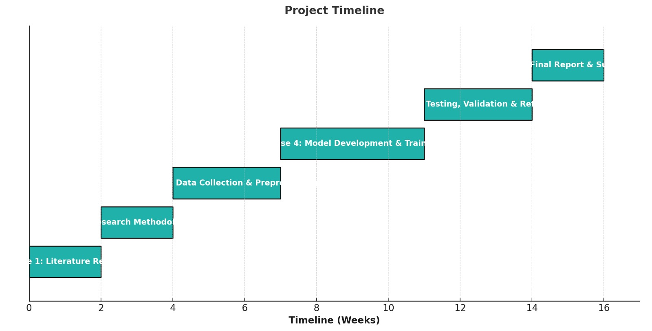
Timeline of the Project (Gantt Chart)

Slide 12
References (IEEE Paper format)
  [1] A. Vaswani et al., “Attention Is All You Need,” Advances in Neural Information Processing Systems, 2017.
  [2] Google Cloud, “Cloud Text-to-Speech Documentation,” Google, 2024.
  [3] H. Touvron et al., “Large Language Models Are Zero-Shot Translators,” arXiv:2302.13971, 2023.

Slide 13


